Slide 1

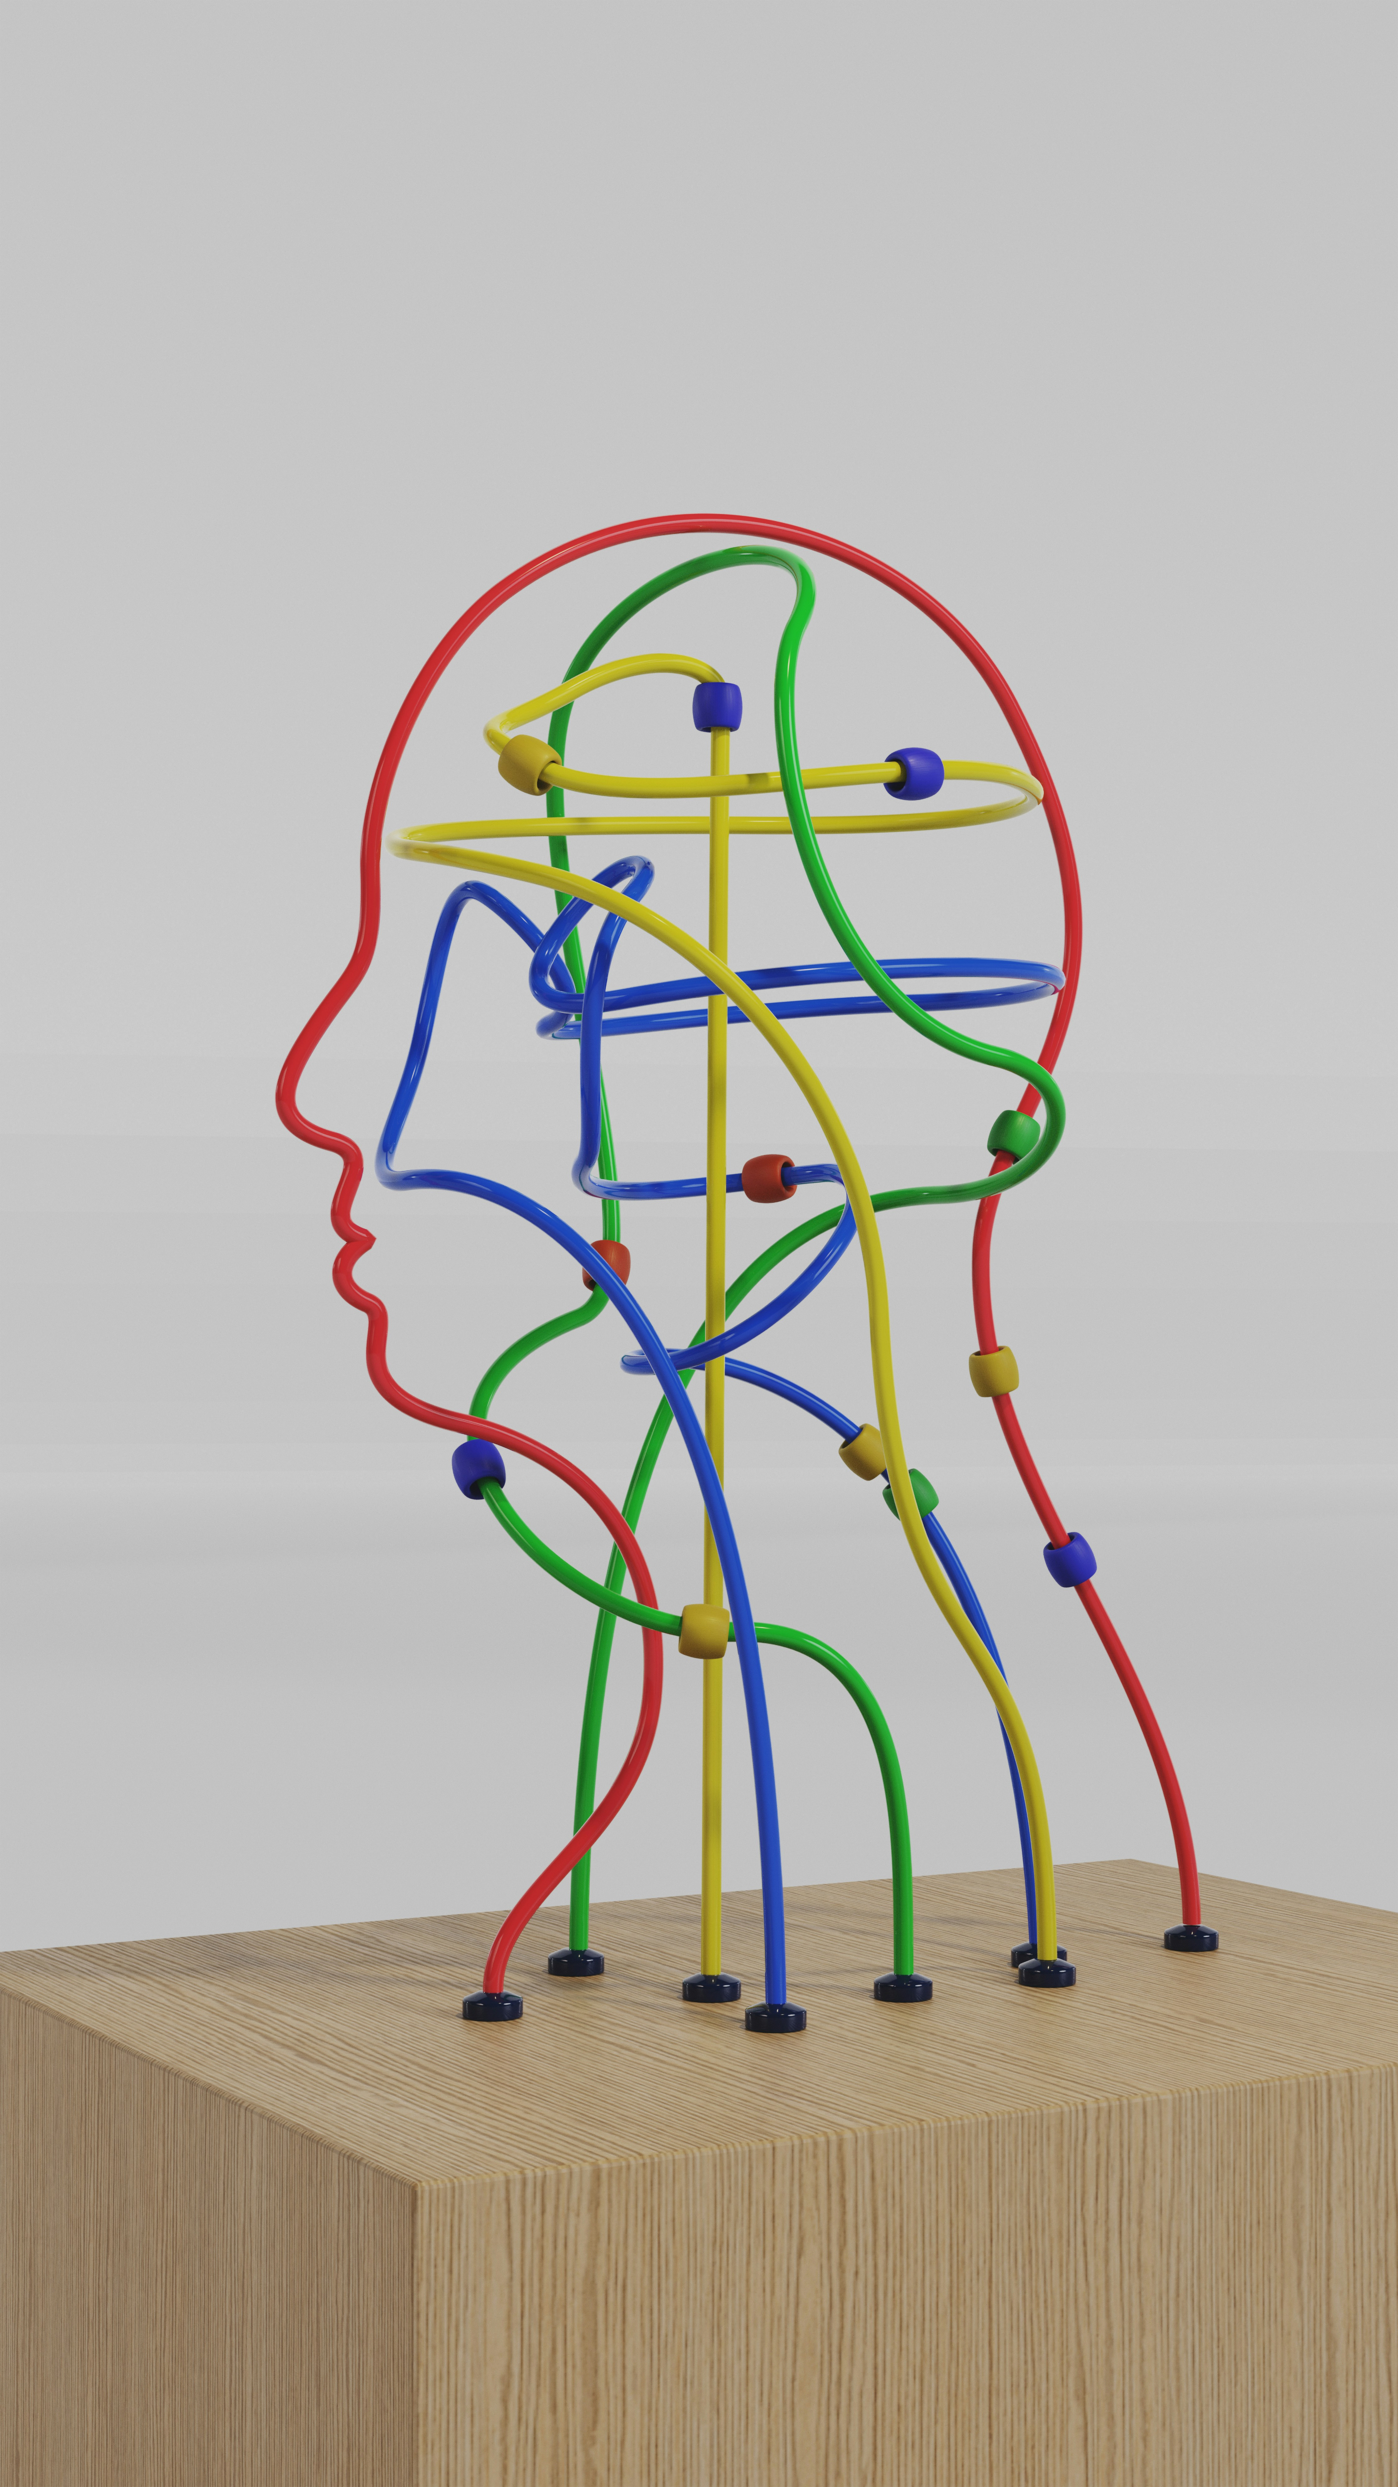
PSYC7142 Understanding Humans Through Data

Slide 2
Objectives for Week 1
By the end of Week 1, you should be able to:
Understand the importance of data analysis and statistics
Identify types of data in psychology (nominal, ordinal, interval, ratio)
Understand means and standard deviations
Understand standardized scores (Z-scores)
Use R-studio to begin to manipulate data, investigate means and standard deviations, and convert scores into Z-scores

Slide 3
Outline for this lecture
Types of data in psychology
Examining distributions of data – means and standard deviation
Standardising scores for data

Slide 4

Types of Data Analysis
Quantitative Methods
  Testing theories using numbers
Qualitative Methods
  Testing theories using language
    Magazine articles/Interviews
    Conversations
    Newspapers
    Media broadcasts
Notes:
“Qualitative research is multimethod in focus, involving an interpretive and naturalistic approach to its subject matter. This means that qualitative researchers study things in their natural things, attempting to make sense of, or interpret, phenomena in terms of the meanings people bring to them”(Denz & Lincoln,1994, p.2)

Slide 5
Types of Data
Numbers have three important functions for researchers:
  Classify or categorise - Nominal data
    E.g. male/female, young/old, red/green/blue
    Each case can only be in one category.
  Rank or order - Ordinal data
    E.g. first, second, third…
    Does not indicate magnitude of differences between ranks.
  Score – Interval/Ratio data
    E.g. number of correct answers, reaction time
    Tells us about the order of data but also the distance between them.

Slide 6
Types of Data: statistics
Depending on the type of data you have in your study, the statistics that you explore will vary
We will learn about these different statistics over the next 10 weeks

Slide 7
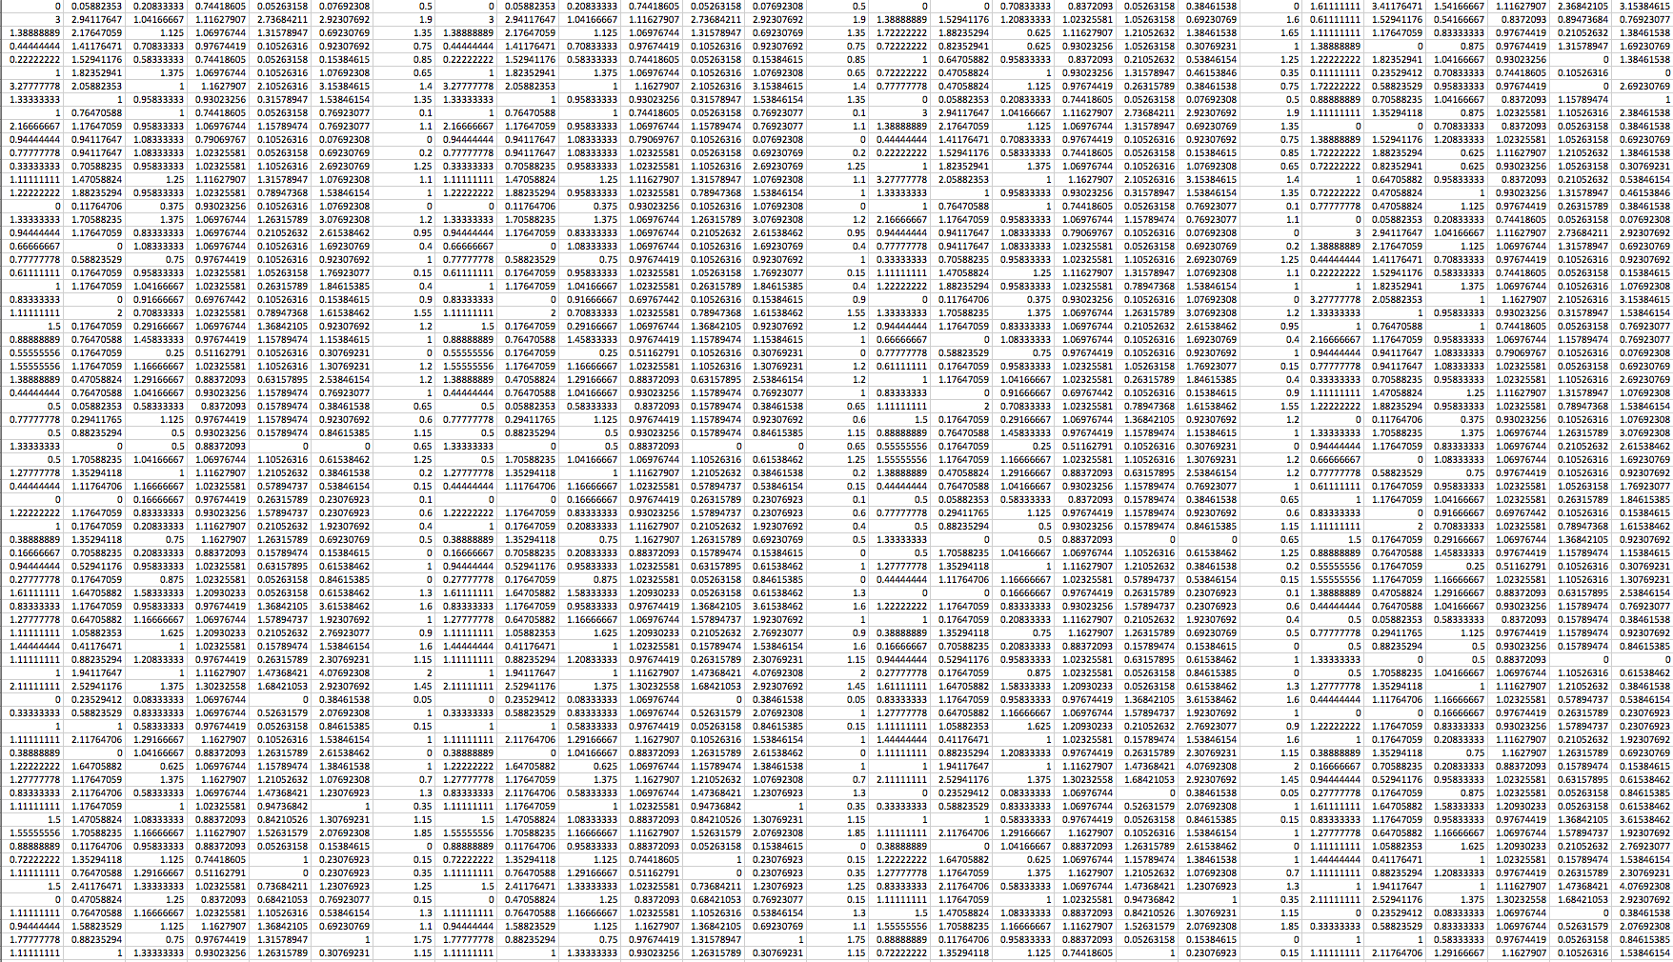
Data
Notes:
Who can tell me what these data look like?

Slide 8
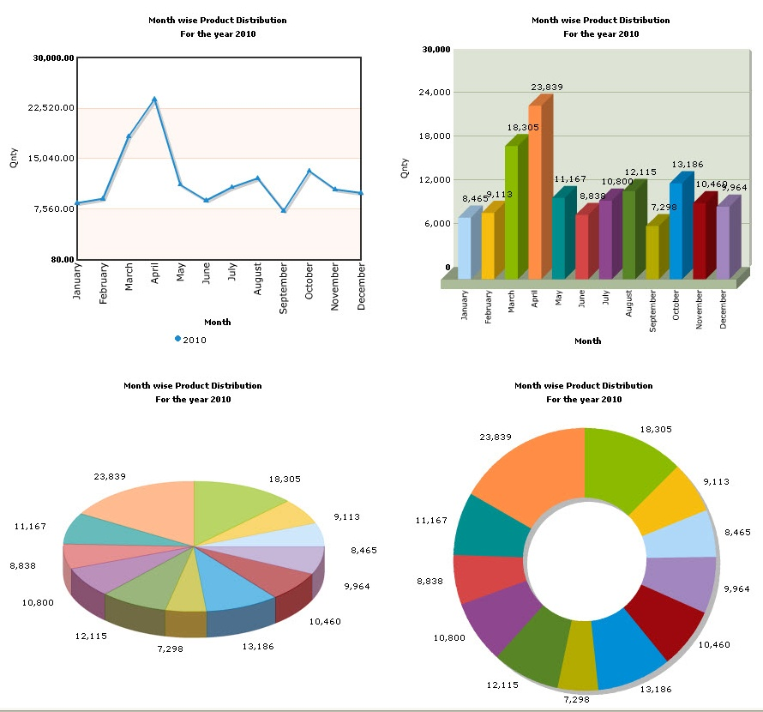
Plotting data
When you have a lot of data, it is very difficult to interpret them at a glance.
One of the simplest methods to reorganise data to make them more intelligible is to plot them in some sort of graphical form.

Slide 9
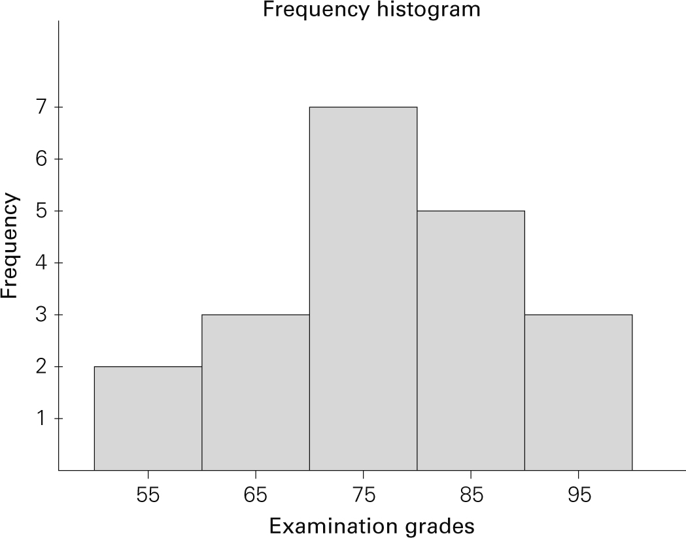
Plotting data: leaf and histogram
Data: {55,95,85,75,75,85,65,75,65,85,75,75,85,75,75,55,65,85,95,95}
Leaf diagram
55,55
65,65,65
75,75,75,75,75,75,75
85,85,85,85,85
95,95,95
Histograms plot:
  The score (x-axis)
  The frequency (y-axis)

Slide 10
Why plot/organise your data?
Histograms help us to identify:
  The shape of the distribution
  Unusual scores

Slide 11
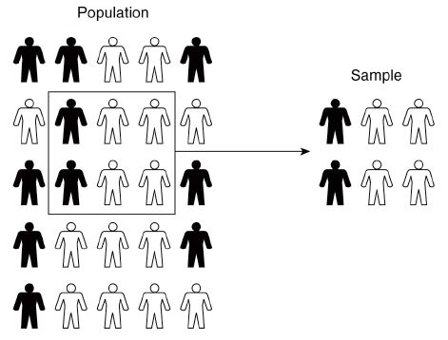
Samples and statistics
→ You can’t test everyone: Get a sample
We assume (or test whether) the actual data from the sample approximates patterns found from the whole population
  This is called inferential statistics
Notes:
What is the likelihood it’s just a fluke or the real deal?

Slide 12
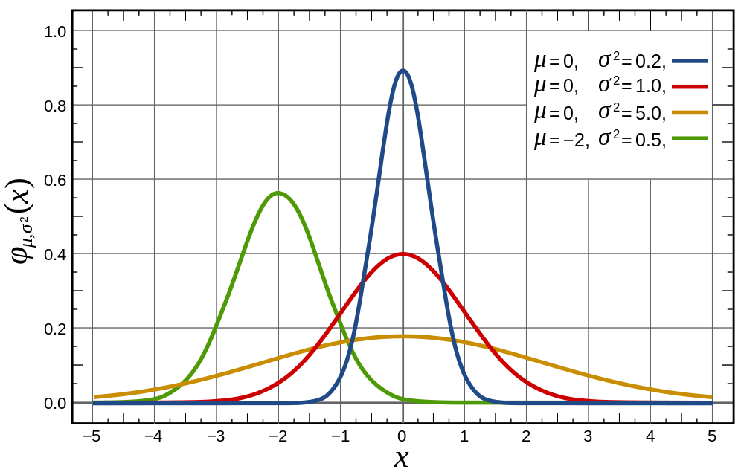
Normal distribution
Mean (μ) – Determines the location of the centre of the graph

Slide 13
Measures of central tendency
These provide you a single value that describes the way in which a group of data clusters around a central value, i.e. the centre of a data set.
There exists three measures of central tendency:
  Mode
  Median
  Mean
  Each better suited for specific levels of measurement
  (Nominal, Ordinal, Interval, Ratio)

Slide 14
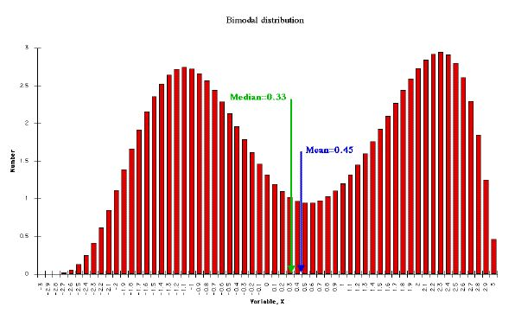
Mode
The most frequent score/data
Level of measurement: Nominal, ordinal or interval/ratio
Shape of distribution: Bimodal or multimodal

Slide 15
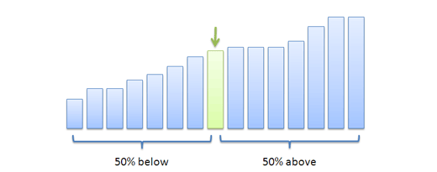
Median
The middle score when scores are ordered.
Level of measurement: Ordinal or interval/ratio

Slide 16
Mean (μ)
It is the average, i.e. the sum of all scores (x_{i}) divided by the number of scores (n).
Level of measurement: Interval or ratio

Slide 17
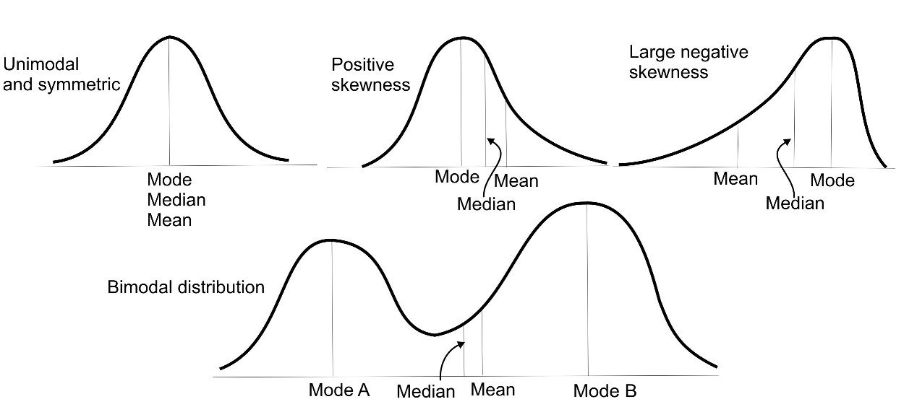
Which is your data?
Normal distribution

Slide 18
Normal distribution: Reminder
We assume (or test) that the actual data comes from a “normal distribution” of data
The shape of the normal distribution depends on two factors:
  Mean (μ) – Measure of central tendency
  Standard Deviation (σ) – Measure of variability

Slide 19
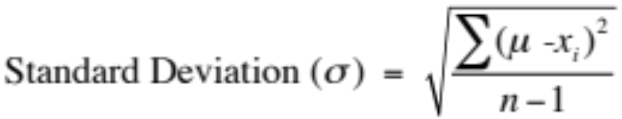

Measure of variability from a sample
Standard deviation (σ): Measure of the typical deviation from the mean.
Where is the mean
x_{i} is each data point
n is the number of data points

Slide 20
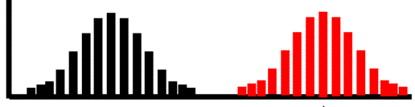
Standardising scores: Who’s the cleverest?
You give the same IQ test to 134 8 year olds, and 265 26 year olds
It’s not really fair to compare the 8 and 26 year olds
But you can investigate scores within the 8 year olds and within the 26 year old groups
  Now it’s helpful to standaridse the scores – how an individual stands in relation to the rest of their population
8 year olds
26 year olds
Frequency
IQ score

Slide 21
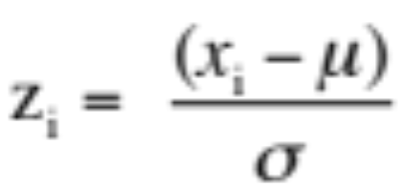
Z-scores
Z-scores allow you to compare data from different distributions because they are standardised scores.
  Z-scores expresses a score in terms of how many standard deviations it is away from the mean.
All z-scores from a sample set have a mean of 0 and a standard deviation of 1.
where z_{i} is the z-score for data point x_{i}
and σ is the standard deviation

Slide 22
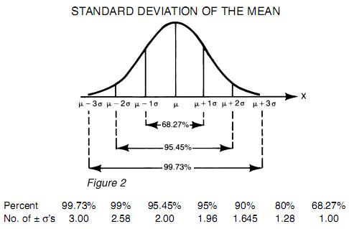
Properties of Z-scores
As such, 95% of z-scores lie between −1.96 and 1.96.
99% of z-scores lie between −2.58 and 2.58,
99.9% of them lie between −3.29 and 3.29.

Slide 23
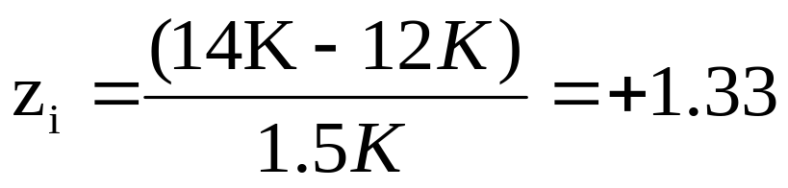
Example of z scores
In a large company, the mean annual income is £12K and the standard deviation is £1.5K. How does Geoff’s £14K income compare with his colleagues?
where z_{i} is the z-score for data point x_{i}
and σ is the standard deviation

Slide 24
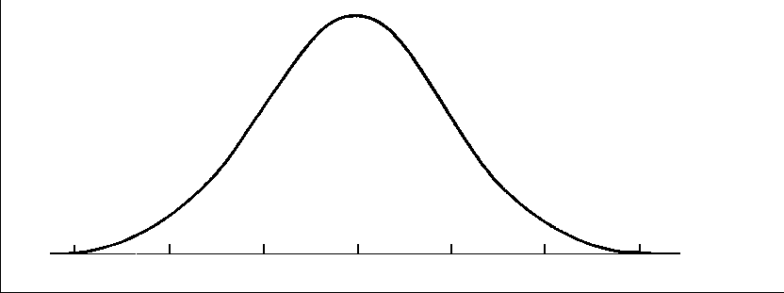
Standard distribution of z scores
Geoff’s earns 1.33σ more than the average salary in his company.
Probability Function
+1.33σ
12K 14K

Slide 25
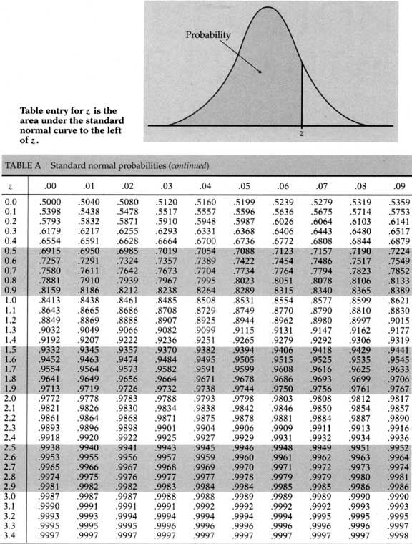
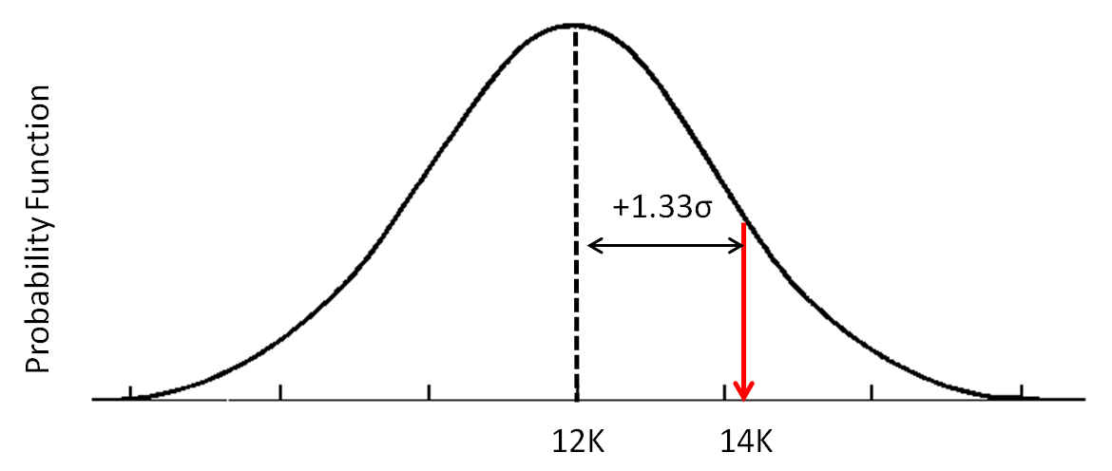
Z-table
→ Geoff earns more than 90.82% of his colleagues

Slide 26
Summary
Types of data
  Nominal, ordinal, interval/ratio
Distributions of data
  mean, median, mode, standard deviation
Standardised scores, and their interpretation
  Converting Z scores to probabilities

